Slide 1

21428 - WHEN I GO HOME - Title

Slide 2
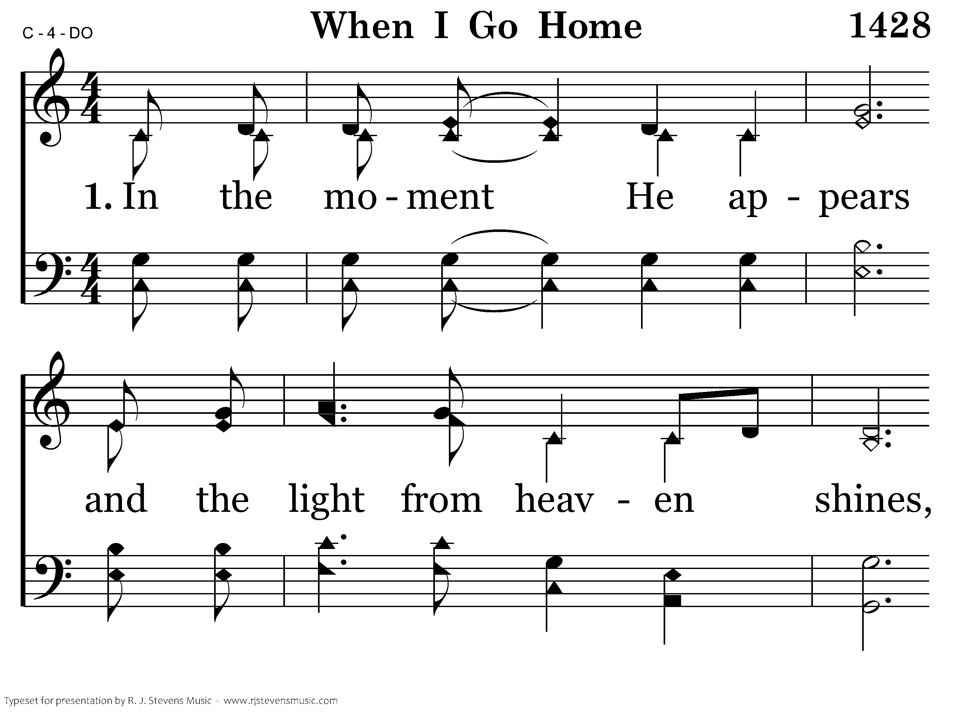
21428 - WHEN I GO HOME - 1.1

Slide 3
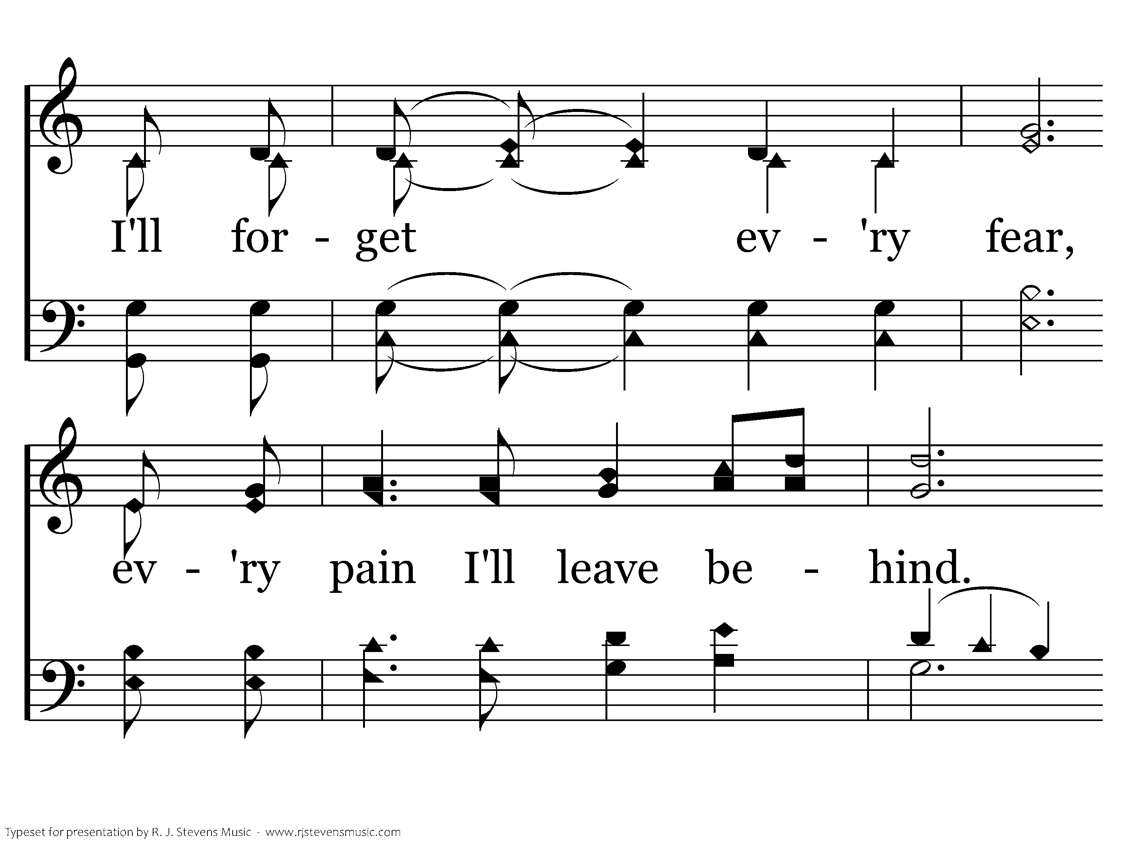
21428 - WHEN I GO HOME - 1.2

Slide 4
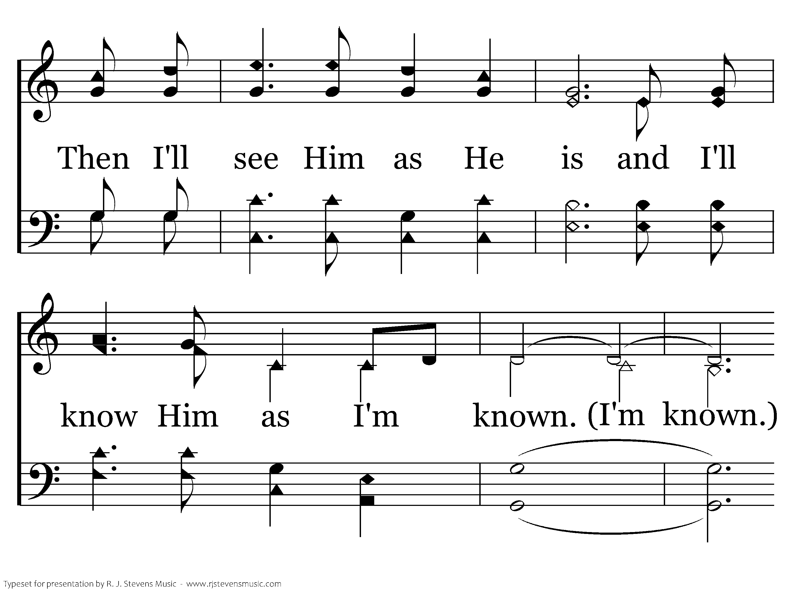
21428 - WHEN I GO HOME - 1.3

Slide 5
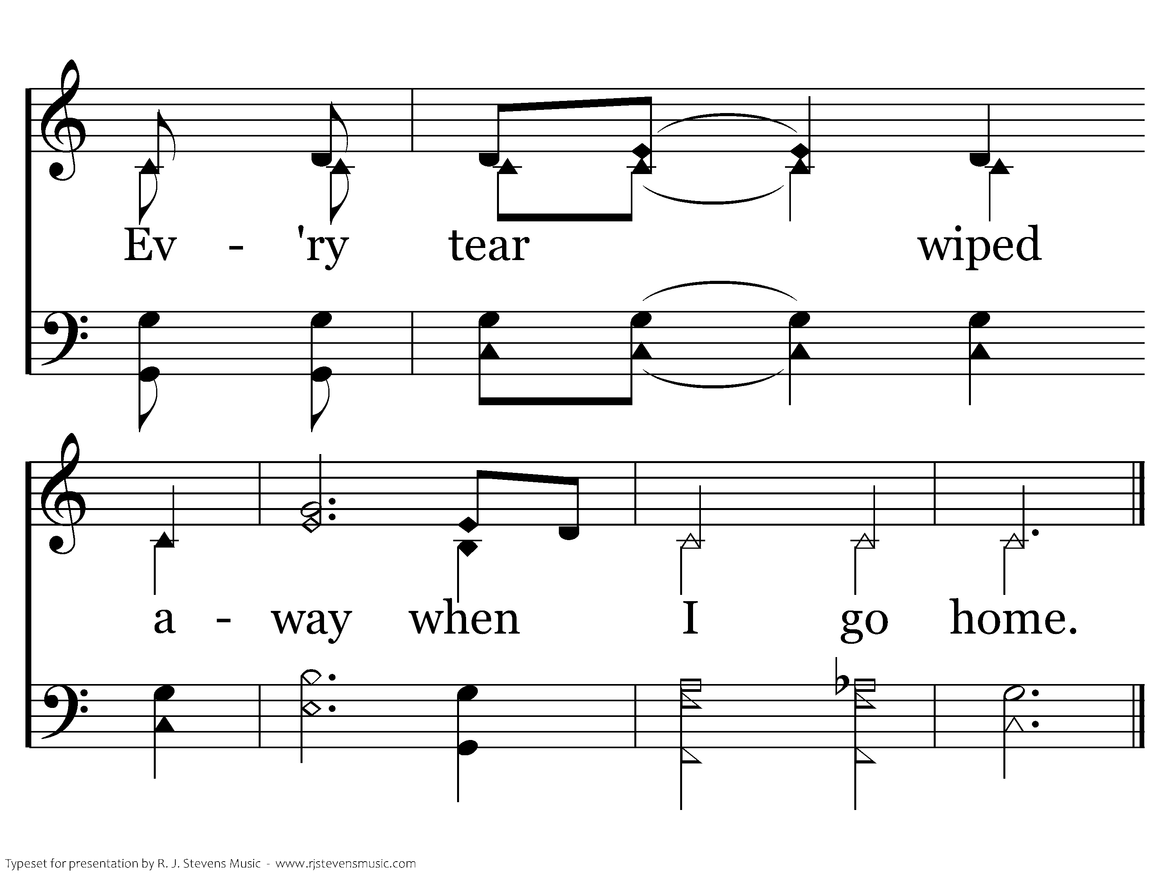
21428 - WHEN I GO HOME - 1.4
End of Verse 1

Slide 6
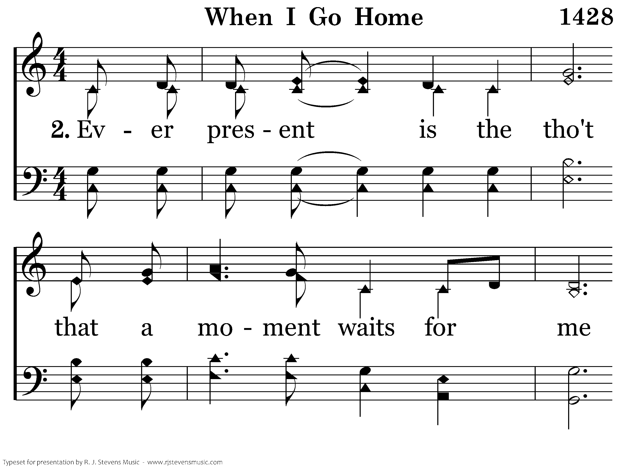
21428 - WHEN I GO HOME - 2.1

Slide 7
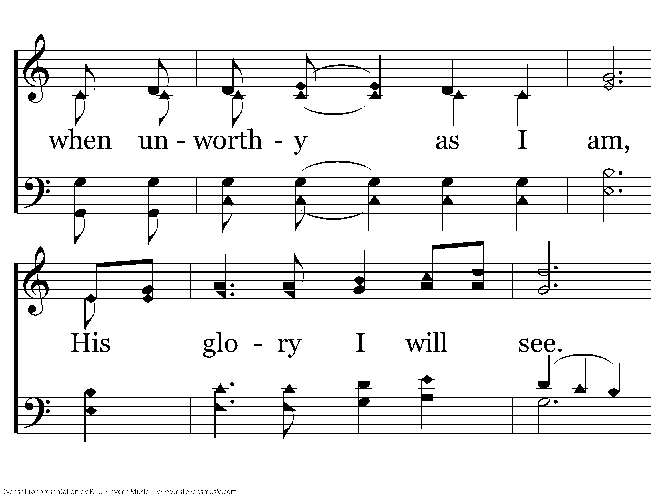
21428 - WHEN I GO HOME - 2.2

Slide 8
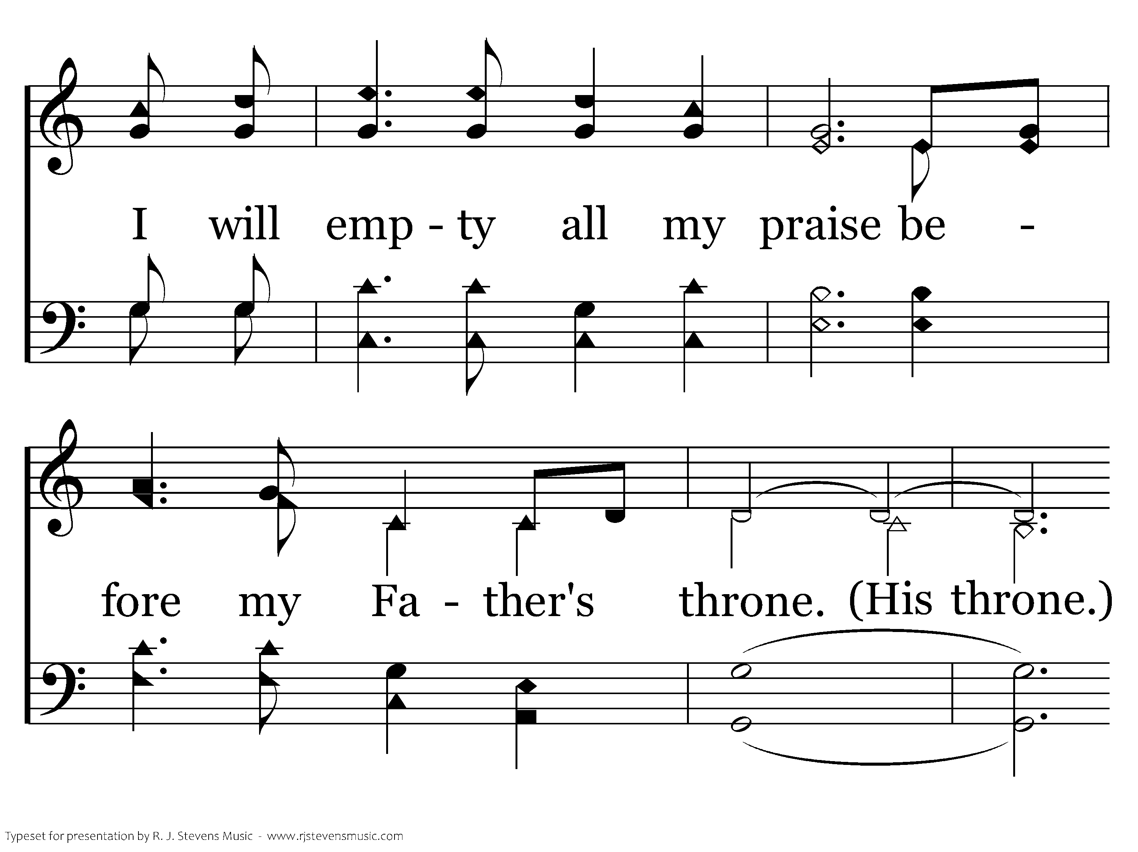
21428 - WHEN I GO HOME - 2.3

Slide 9

21428 - WHEN I GO HOME - 2.4
End of Verse 2

Slide 10
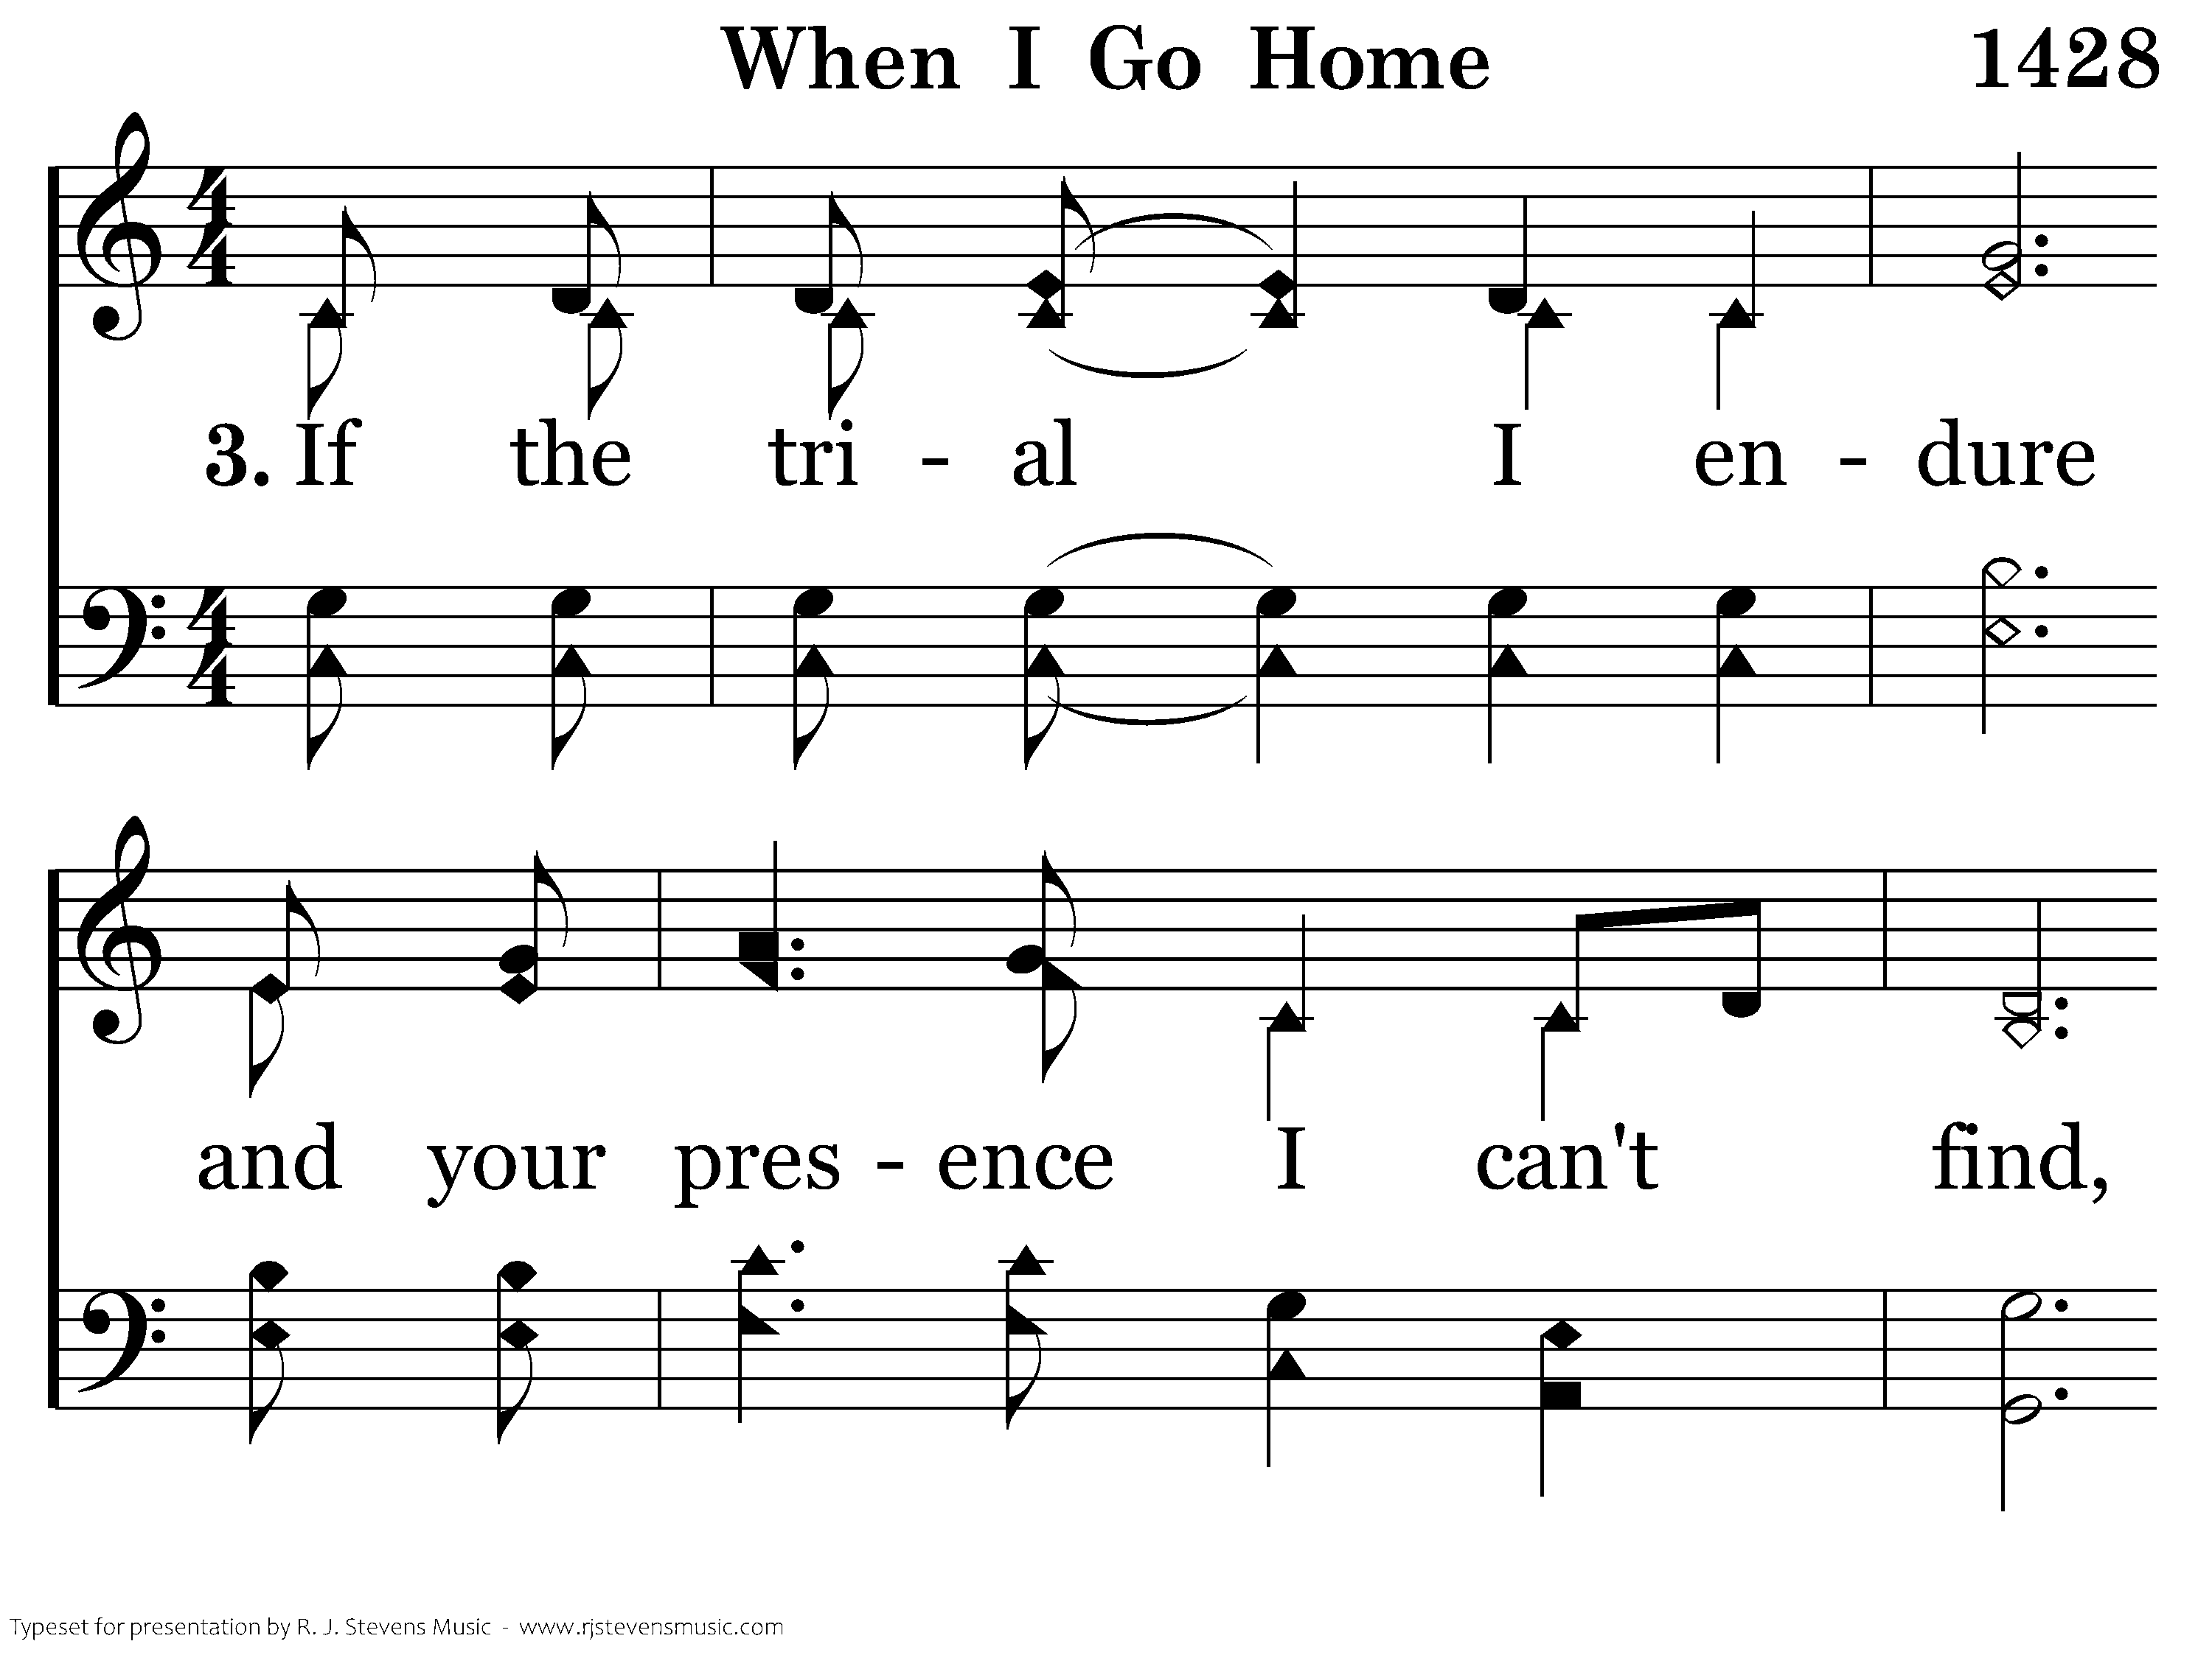
21428 - WHEN I GO HOME - 3.1

Slide 11
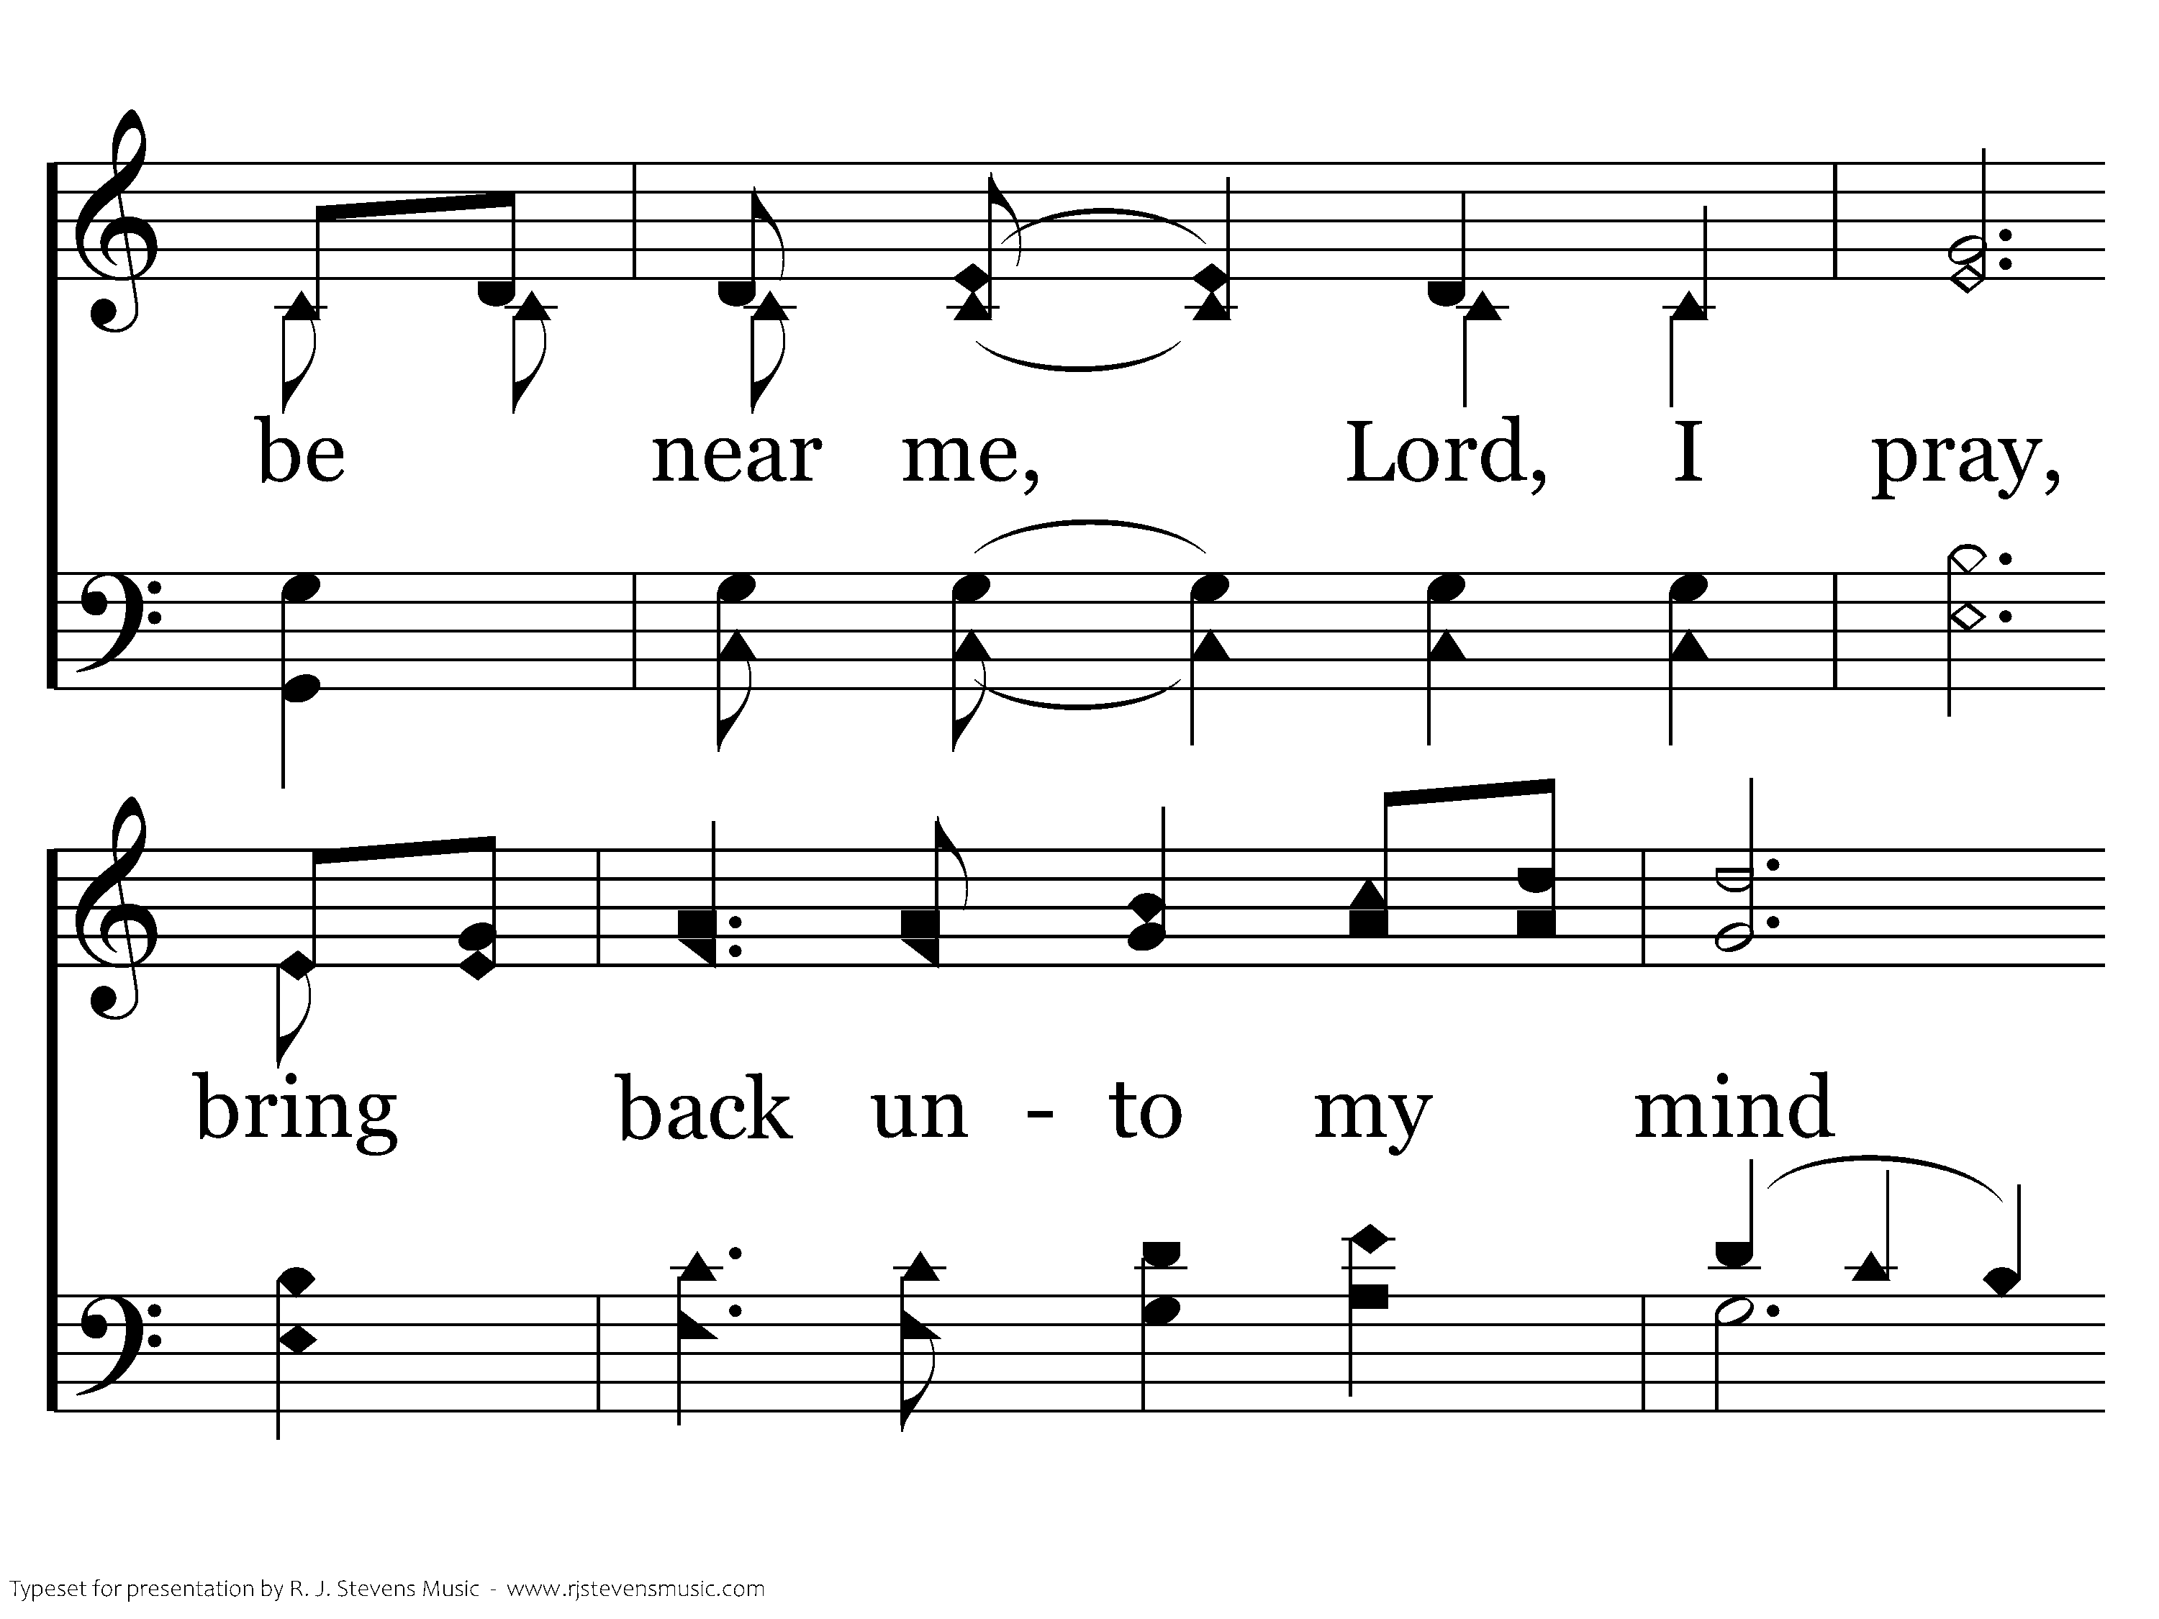
21428 - WHEN I GO HOME - 3.2

Slide 12
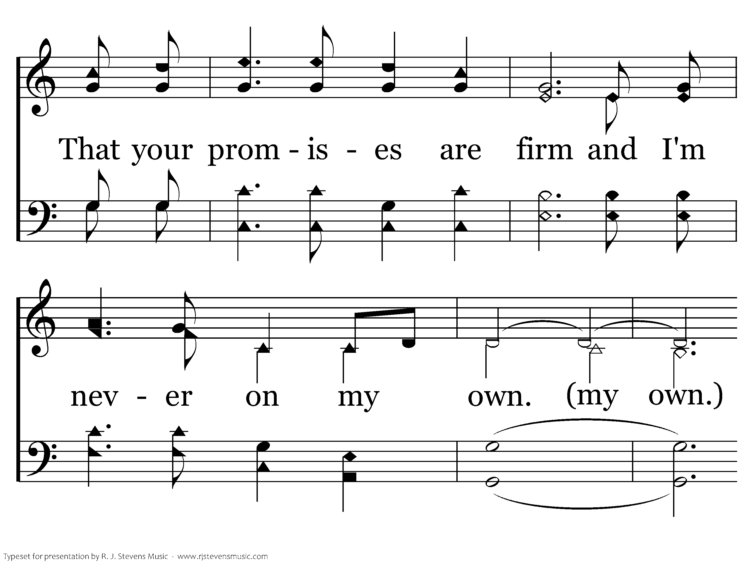
21428 - WHEN I GO HOME - 3.3

Slide 13

21428 - WHEN I GO HOME - 3.4
End of Song

